Slide 1
Project Title: Digital Lending Journey in Developed Nations
Project Guide: Sudhanshu Modi
Project Mentor: Fahad Aman
Project Buddy: Divyansh Kavadia
Intern: Harikishan T S
Campus name: Indian Statistical Institute, Kolkata

Slide 2
Project overview
Aim:
To analyse how digital lending is being carried out in developed nations and identify challenges and solutions they have adopted in digital lending.
Approach:
Research digital lending practices in developed nations using open-source and online resources.
Identify challenges and solutions implemented in those nations.
Assess the feasibility of applying those solutions in the Indian market.
Demonstrate a use-case scenario to showcase the proposed solution benefits.
Outline future improvements and considerations.

Slide 3
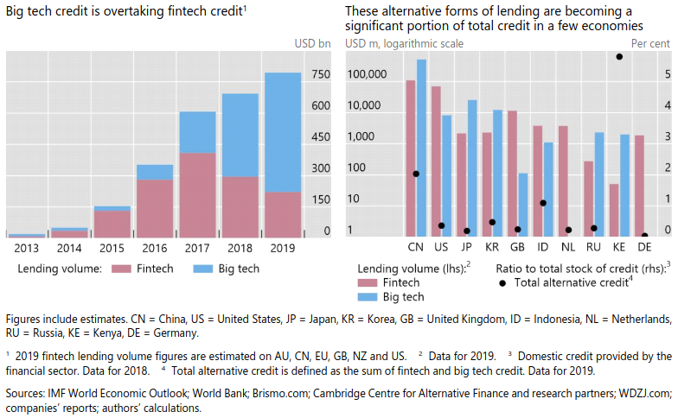
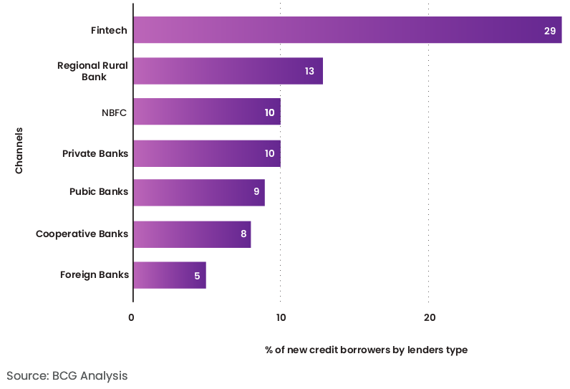
Digital lending overview on different countries
Global alternative credit (FinTech credit + BigTech credit) as of 2019: $795b ($223b FinTech + $572b BigTech)
China - Largest FinTech and BigTech
Largest BigTech lending in China, Japan
Largest FinTech lending in China, USA
Source: BIS Working Papers No 887 Fintech and big tech credit: a new database
For India in 2020,
Ratio of digital credit to GDP is 0.62% ($16.5b/$2670b)
Ratio of digital credit to total credit is 2.4% ($16.5b/$687.4b)
Banks: 2.07% ($13.7b/$661.1b), NBFCs: 10.64% ($2.8b/$26.3b)
For India, based on data upto 2018
Notes:
FinTech - Companies who makes use of innovative technologies applied to the financial industry. Ex: Ant Group, PayPal, Stripe, Fiserv
BigTech - Primarily business is Technology, who have entered credit markets, lending either directly or in partnership with financial institutions. Ex. Amazon, Google, ebay
China - BigTech: Tencent, Alibaba, Xiaomi; FinTech: Alipay, Ant group
India - BigTech: ; FinTech: PhonePe, Paytm,
US - BigTech: Amazon lending program,

Slide 4
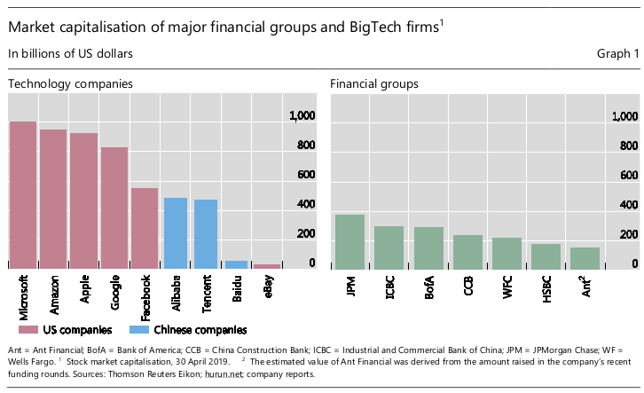
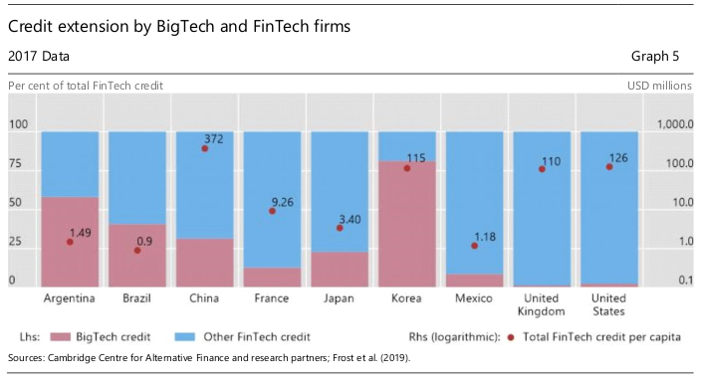
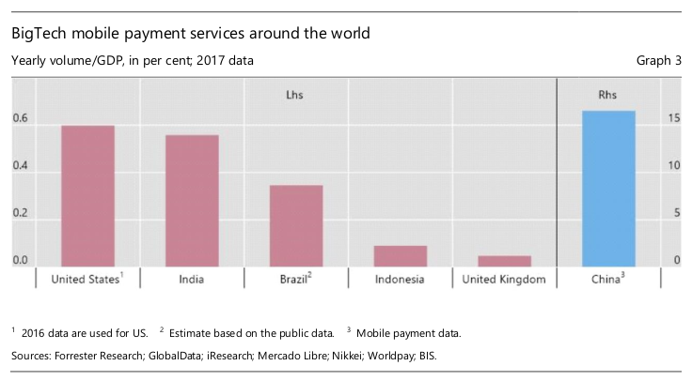
BigTech vs Financial groups
Payment Services Directive (PSD2) in 2018.
Enables BigTech to access payments-related data.
Source: BIS Working Papers No 887 Fintech and big tech credit: a new database

Slide 5
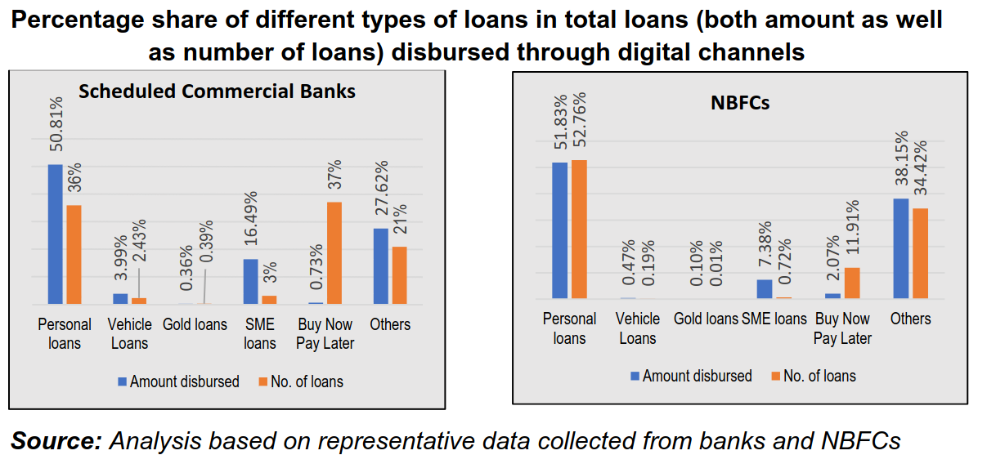
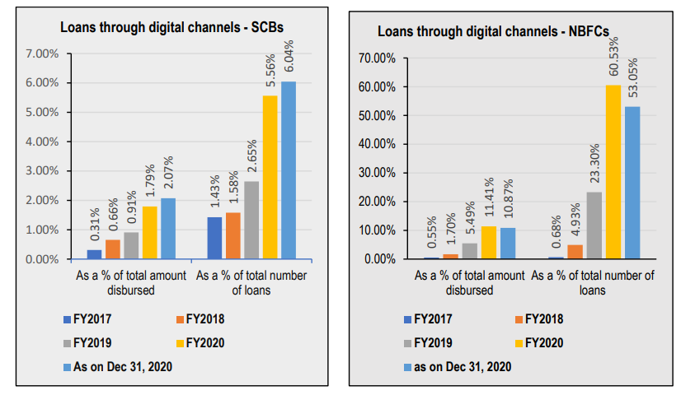
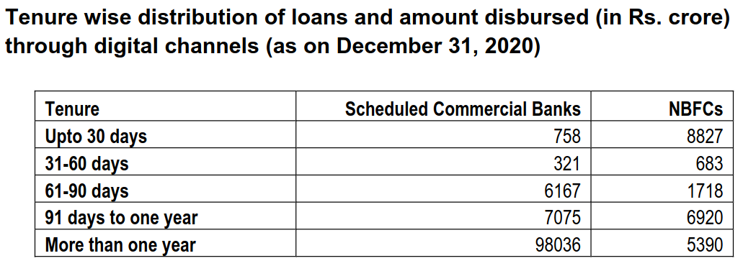
Banks vs NBFCs in India
Source: RBI report of the Working Group on Digital Lending includingLending through Online Platforms and Mobile Apps
Smaller ticket size loans are offered digitally. Major product disbursed digitally – Personal loans, SME loans.
NBFC gives appx 50% loans through digital channels; Banks only give 6% loans through digital channels.
NBFCs tenure of loans – 23% loans are more than 1 year; Banks tenure of loans – 87% loans are more than 1 year.
Indicates that NBFCs have more disbursement through digital channel because they are giving short term loans.
Note: Loans under ‘others’ category for banks comprise mostly of small business and trade loans, home loans and education loans.

Slide 6
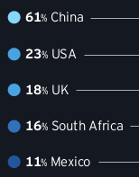
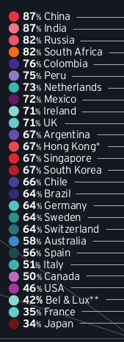
Global FinTech adoption
Source: Global FinTech adoption index 2019
SME adoption
Consumer adoption
In 2019, global survey by EY.
27,000 consumers in 27 markets.
1000 SMEs in 5 markets.
China adoption rate is high, because of more willingness to share data.
 | Consumers | SMEs
Global FinTech adoption rate | 64% | 25%
Willing to share bank data with FinTech services | 46% | 89%
Use non-financial service company for financial services | 68% | 46%

Slide 7
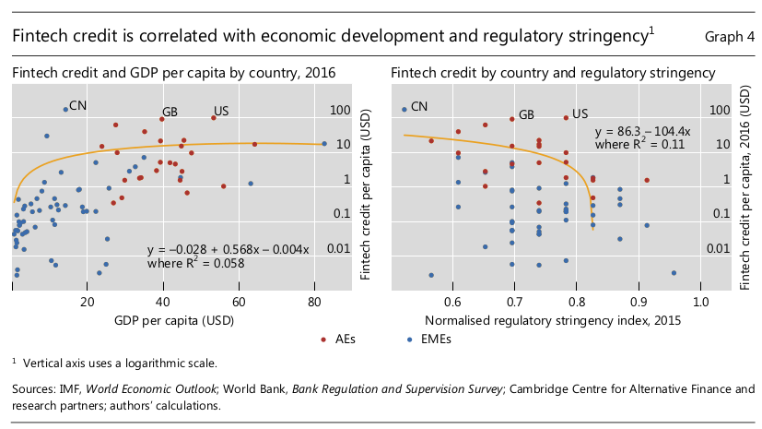
Effect of regulatory stringency on FinTech credit
In 2016, India, FinTech credit per volume is 0.1 USD.
For China, 174.2 USD.
For US, 100.2 USD.
Advanced economies have more FinTech credit per capita indicating more FinTech credit promotes growth in GDP per capita.
Financial depth proxied by ratio of credit to GDP.
Regulatory stringency is similar in Advanced Economies (AEs) as well as Emerging economies (EMEs).
Source: Fintech credit markets around the world: size, drivers and policy issues

Slide 8
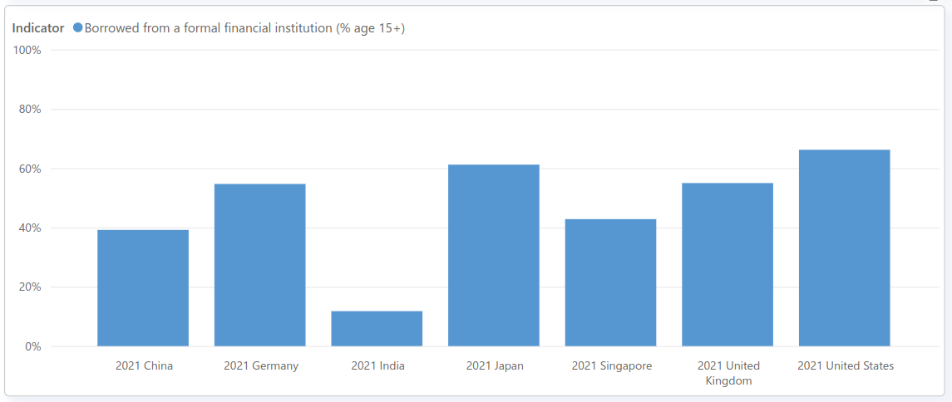
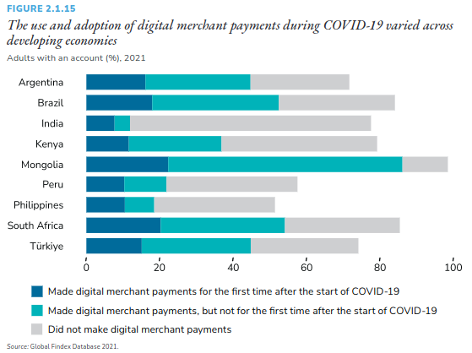
Challenge: Financial inclusion
Source: World Bank Data, Global Findex 2021 Report
As of 2021, in India, 77.5% of population has bank accounts. In Developed countries, more than 95% people have bank accounts.
India significantly increased first time usage of online payments but still many account holders did not start online payments.
In 2021, Indian population who borrowed is 11.8% which is very less compared to developed countries.
Reason might be not enough knowledge on how to make digital payments, no access to internet.
Solution: Provide digital infrastructure, replace cash payments by digital payments to bring more customers into digital landscape which increase digital lending customer base.
Credit scoring using alternative data allow financial institutions to give loans who does not have credit history.

Slide 9
Challenge: Delinquency rate
Leading fintechs in India reported doubling delinquency rates between August 2019 and 2020, according to a TransUnion CIBIL report.
In US personal loan market, FinTech increased from 22.4% in 2015 to 49.4% in 2019 according to Experian
In US, Sep 2021, Delinquency rate
FinTech: 4.56% (1.82% in Sep 2020)
Banks: 2.23%
NBFCs: 3.77%
FinTech: Avg loan $12,000 in 2016 to $5,548 in 2019
Delinquency rate can be improved if we know more about the customer well before giving loan.

Slide 10
Broad challenges in Digital lending
Regulatory and Compliance Issues
Risk Assessment and Fraud Prevention
Data Security and Privacy
Customer Trust and Experience
Financial Inclusion

Slide 11
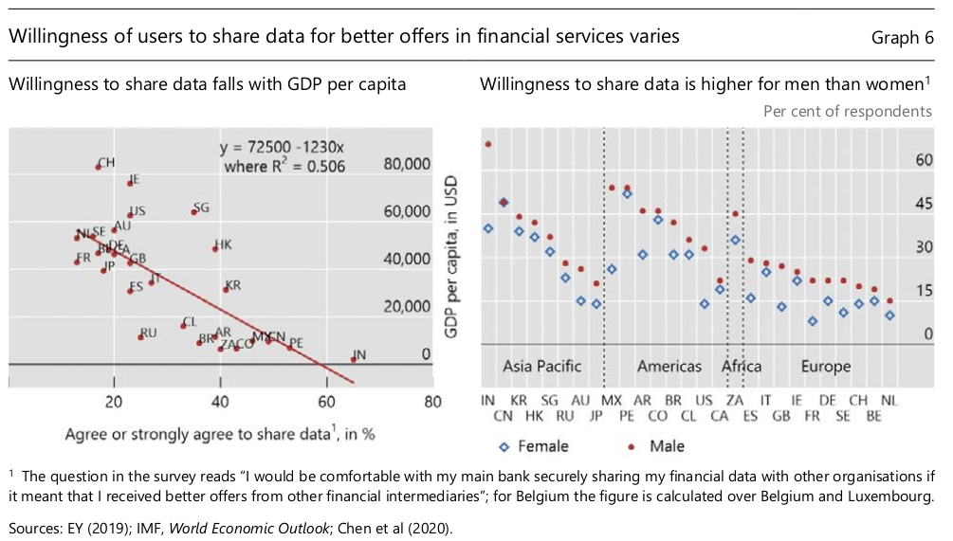
Data privacy
In 2020, India’s GDP per capita was 1,910 USD
In 2020, US GDP per capita was 63,530 USD
Higher GDP per capita countries have less willingness to share data for financial services.
Source: World bank Data, Global Findex Database

Slide 12
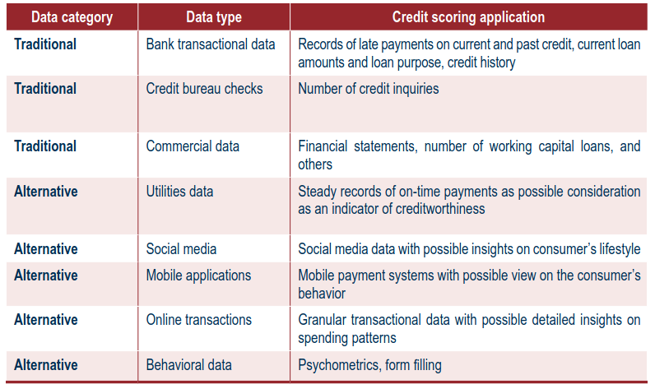
Alternative credit scoring using alternative data
Challenges of digital lending
Delinquency rate increases.
Financial inclusion not possible if we use only traditional credit data.
Why do we need to use alternative data?
Leverage openly available digital data to gain more information about customers beyond traditional credit data.
Improve accuracy of existing default prediction model.
Evaluate individuals with limited credit data.
Even world bank listed alternative source for credit scoring indicating the possibility to use these data sources.
Source: CREDIT SCORING APPROACHES GUIDELINES
Challenges
Privacy, bias, and data accuracy. However, ethical and responsible use of data can be carried out.
Consumers might change their behavior if digital footprints are widely used for lending decisions.

Slide 13
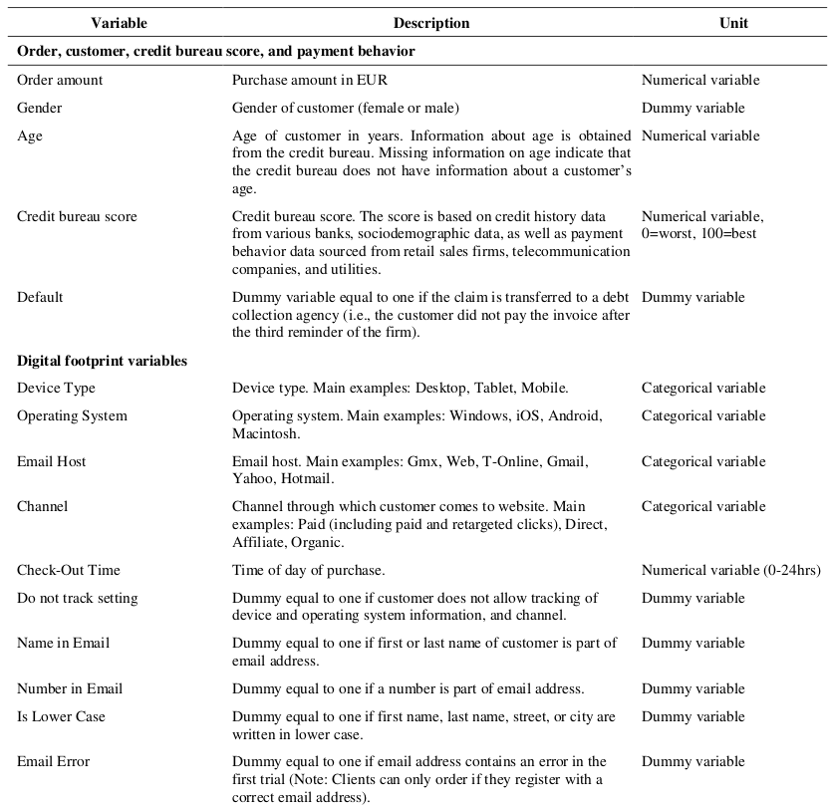
Credit Scoring using Digital Footprints
Source: On the Rise of the FinTechs—Credit Scoring using Digital Footprints by FDIC CFR
This study has used data of 270,399 purchases at a German E-commerce company between October 2015 and December 2016.
Obtain behavior data from retail sales firms, telecommunication companies, and utilities
Proxy for income, character, reputation.
Digital footprints today can forecast future changes in the credit score.
Challenge: Consumers might change their behavior if digital footprints are widely used for lending decisions.

Slide 14
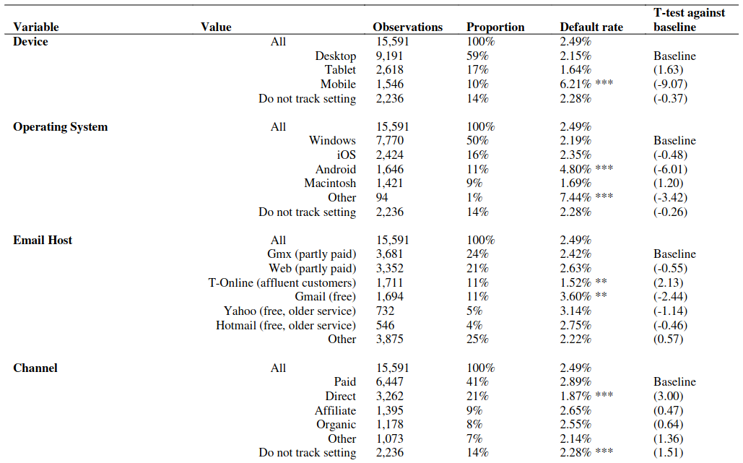
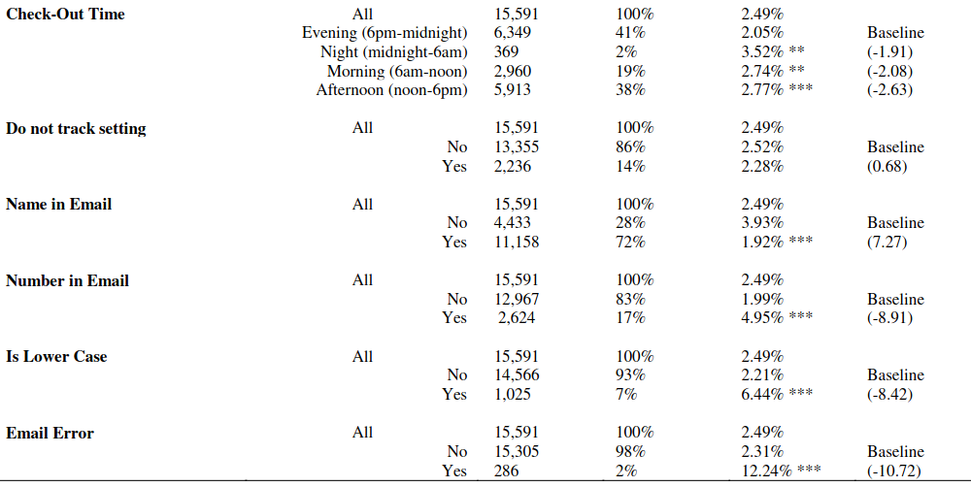
Results of the study by FDIC
Is alternative data source reliable? Answer is Yes.
This study has used data of 270,399 purchases at a German E-commerce company between October 2015 and December 2016.
Accuracy of default prediction (0/1) using logistic regression.
68.3% Only credit bureau score
69.6% Only digital footprint
73.6% Both
Source: On the Rise of the FinTechs—Credit Scoring using Digital Footprints by FDIC CFR
Challenges:
Models remain untested over longer credit cycles or in case of a market downturn.
Lack of quality of data and lack of transparency/explainability around the mode
Model can be biased. Ex: Firm may not include gender-based variants as input to the model, but the model can infer the gender based on transaction activity.
Source: Artificial Intelligence, Machine Learning and Big Data in Finance: Opportunities, Challenges, and Implications for Policy Makers

Slide 15
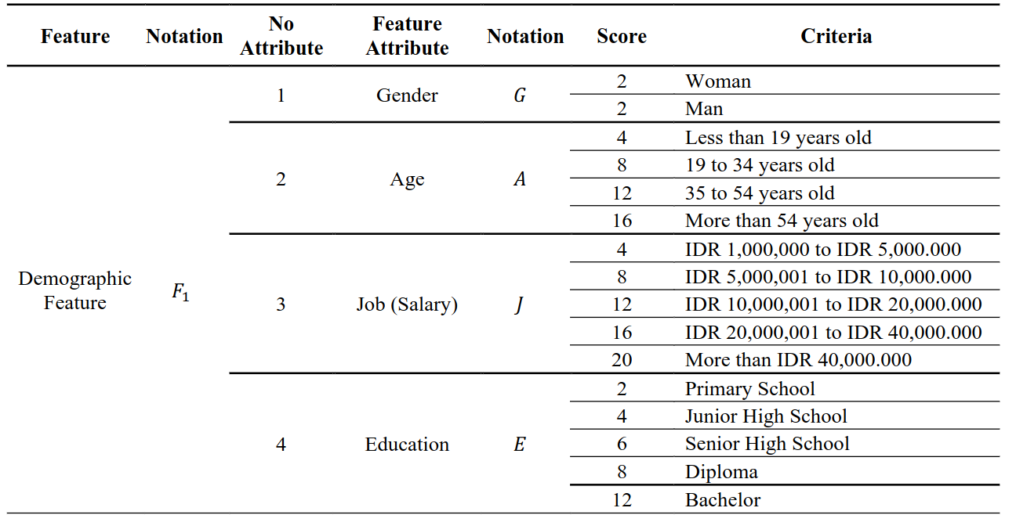
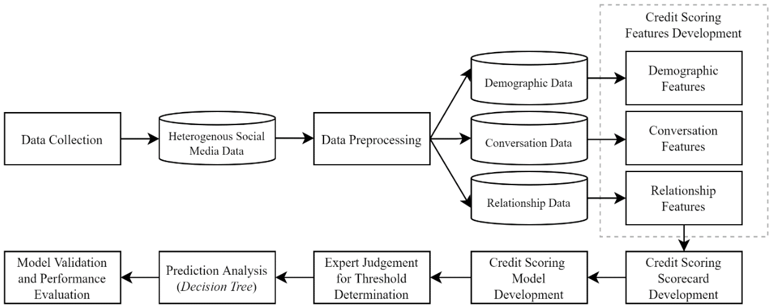
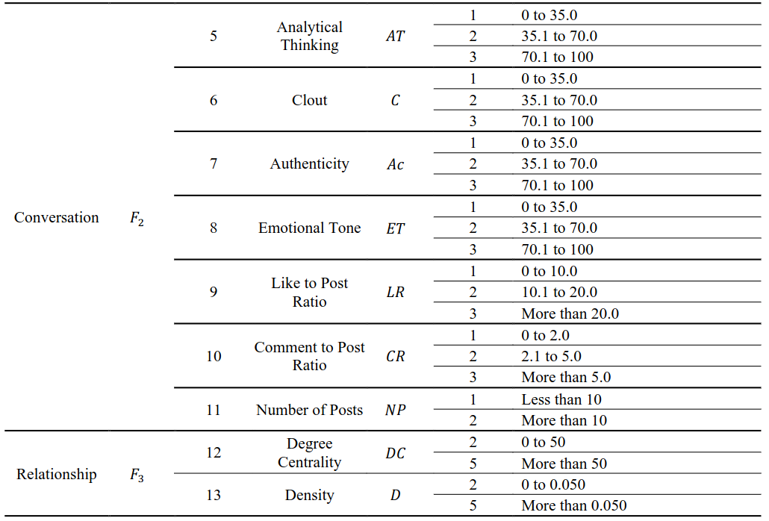
Implementation of Credit scoring using Linkedin
Source: Credit Scoring Model Construction Based On LinkedIn Social Media Data
Data Collection:
From python environment, search in Google with query "Customer_name Linkedin". We get list of user profiles Phantombuster, a web scraping tool, can extract information of users and store in json format.
Data Pre-processing:
Extract required data from json file and categorize into Demographic, Conversational and Relationship data.
Conversational data:
Posts, comments by the user which reflect user behaviour.
It is subjective but can be quantified using NLP techniques.
GPT 3.5 model integrated with Python environment can be used to give rating for the sentence.

Slide 16
Challenges and limitations of the implemented credit scoring model
Cannot use Customer name and email ID to search profiles in Linkedin due to privacy violation.
Need of using third party Phatombuster API which requires an active linkedin account for signing in and then extracting profile information.
For searching 2.5 crore customers in Linkedin, our access to profile might get blocked due to overuse.
Restriction of usage of open source GPT models for text analysis. However, NLP models can be built internally for processing text which involves technical challenges like lack of quality data, accuracy, time to build model etc.
Same customer name might be present. Email ID present with bank will be different from what he/she used in linkedin profile.
Need to get customer consent on using their linkedin data.
Not all customers are present in Linkedin. Some profiles are private.
Sometimes, customer profiles are old and outdated.
Presence of fake information in Linkedin.

Slide 17
Learnings throughout the Internship period
Understood about how pre-approved loans is given to different customers within the bank.
Web scraping using Python to efficiently extract information from internet and convert to structured format for further processing.
Integrated GPT models with Python for text analysis using prompt engineering.
Implementation of end to end credit score model extracting information from social media and giving a credit score.
Automation of hyper-parameter tuning in Decision tree using Bayesian optimization and discussed with the whole team for future use.

Slide 18
Appendix
All files related to project is available in github
Final PPT
Linkedin credit score model
Web scraping of google and integration with ChatGPT
Bayesian hyper-parameter tuning

